Slide 1
INTERNSHIP WITH ENTECH(Efficient group)
Presented By:
Mr.Shrinivas Kotabagi 2JI15CS046
Under the Guidance of
Prof. Suhas Honamore

Slide 2
ABOUT THE ORGANIZATION
“Entech is the Interactive web design and development company in Belagavi which provides the fresh, creative and interactive web resolution”

Slide 3
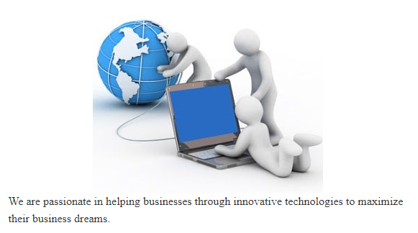
VISION

Slide 4
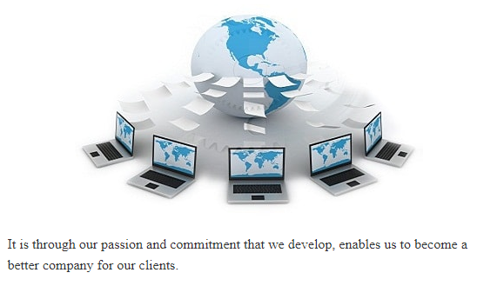
MISSION

Slide 5
OBJECTIVES OF INTERNSHIP
Explore career alternatives prior to graduation.
Gaining a wide experience of a veterinary placement.
Linking theory with practice.
Assess interests and abilities in their field of study.
Learn to appreciate work and its function in the economy.
Develop work habits and attitudes necessary for job success.

Slide 6
Tools and Technologies used in the organization
HTML
HTML is the structure of the website. It is also being called the World Wide Web's mark-up language.
HTML is used for structure and presenting content of the World Wide Web.
An HTML document can provide information for browsers such as what style to use and where to get it.

Slide 7
CSS
CSS is the language which controls the presentation of HTML and its latest version is CSS3.
CSS is the style of the website and it allows using a specific syntax and rules to change how the element looks like in the page.
Currently the CSS4 module is under development. It helps to give a different design to the HTML presentation and to change the colours, layout and fonts of the application.

Slide 8
WAMP Server:
WampServer is a Web development platform on Windows that allows you to create dynamic Web applications with Apache, PHP, MySQL and MariaDB.

Slide 9
Dreamweaver:
Dreamweaver is a web design and development application that provides a code editor with standard features such as syntax highlighting, code completion, and code collapsing.
Dreamweaver features an integrated browser for previewing developed WebPages in the program's own preview pane in addition to allowing content to be open in locally installed web browsers..

Slide 10
Abstract On Project
WEB Site Design for “NICE COMPUTER EDUCATION”.
Where the Web site Consist Five modules
Home page
About us
Services
Gallery
Contact us

Slide 11
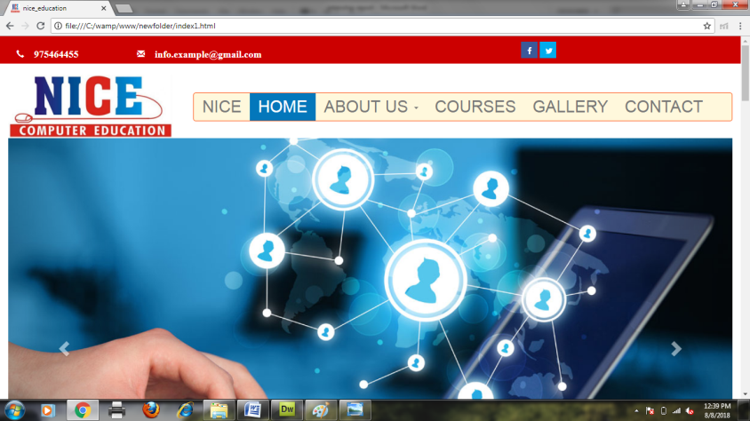
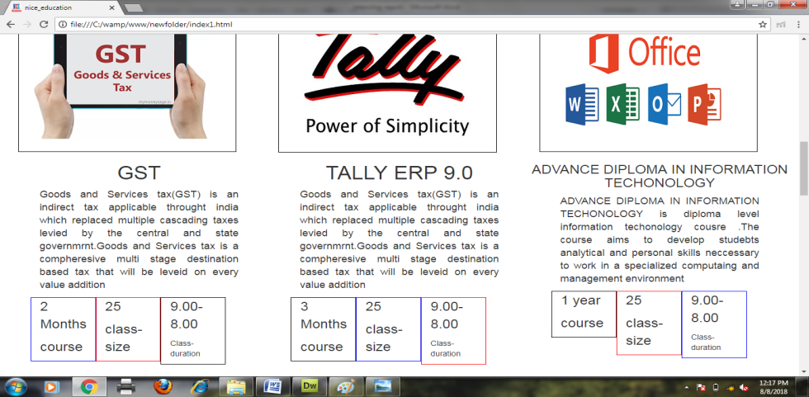
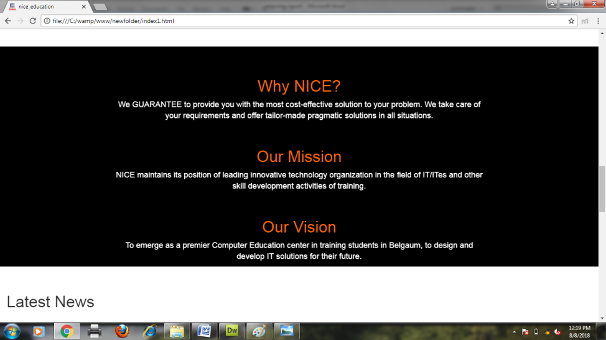
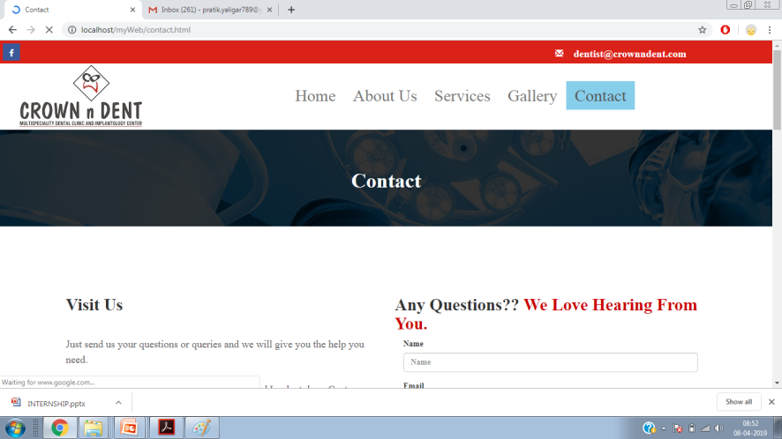
NICE COMPUTER Website

Slide 12
Learning Outcomes
Understand the principles of creating an effective web page, including an in-depth consideration of information architecture.
Become familiar with graphic design principles that relate to web design and learn how to implement these theories into practice.
Develop skills in analyzing the usability of a web site
Understand how to plan and conduct user research related to web usability.
Learn the language of the web: HTML, CSS, JavaScript, and PHP.

Slide 13
THANK YOU

